Slide 1


Obstacle Detection for Low Flying UAS Using Monocular Camera
Fan Zhang, Rafik Goubran, Paul Straznicky
May 16, 2012

Slide 2

Introduction
Autonomous navigation for low flying UAV requires environment mapping and self localization.
Design specification of the UAV from Carleton requires detection of obstacle at 600 meter or further
Available terrain maps do not have enough resolution to detect certain obstacle:
Tall tree, man-made objects, steep hill, etc.
This work did not consider moving objects
Methods:
Monocular camera with inertial sensors
Camera centric EKF based SLAM algorithm
Notes:
For a low flying unmanned aircraft system to navigate in an unfamiliar environment, it requires an accurate model of the terrain, so that it can detect and avoid obstacles, such as small hill, tall tree, electrical towers, etc. To do that, it must obtain accurate 3D range measurement. The common way for range measurement includes laser range finder, and ultrosonic signal. However, these method only provide measurement at a point from a given position and orientation. A new technology developed recently is 3D flash Lidar. It is able to simultaneously capture 3D range measurement in its entire field of view. But these devices are fairly expensive, which limit their commercial use. With the recent advance in computer vision technology and computing power, it is possible to use image sensor for range measurement. In this paper, we presents an inertial aided inverse depth extended Kalman filter that generate terrain map using video captured from single camera.

Slide 3
Sensor Selection
Sensor Review
Range measurement at a point – requires mechanical scanning
Laser Rage Finder
Ultrasonic Signal
Range measurement for the entire field of view
3D flash Lidar -- heavy, and pricy
Image sensor with computer vision algorithm – light, and affordable
Image Sensor Configuration
Binocular
Monocular

Slide 4
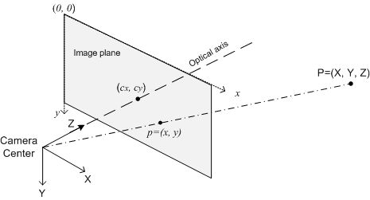
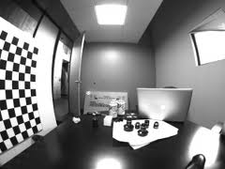
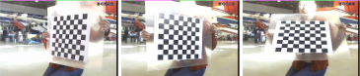
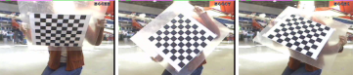
Camera Model and Calibration
Camera Model
Projection Model
Lens Distortion
Radial Distortion
Arise from the shape of the lens
Tangential distortion
arises from misalignment between image sensor and lens
Camera Calibration
Tsai and Zhang

Slide 5
Algorithms Reviews
Machine Vision
Feature Detection: edge, corner
Feature Tracking: dense vs. sparse
Sensor Fusion Framework
Kalman Filter
Fuse odometry and vision, includes results from the past
Minimize sum of squared error
Extended Kalman Filter (EKF)
Used for non-linear model
EKF based Simultaneous Localization and Mapping (SLAM)
Non-linearity, inconsistency
Inverse parameterization & Camera Centric Coordinate

Slide 6
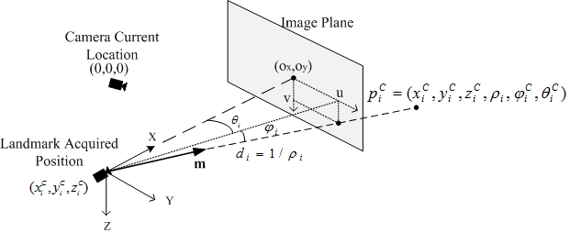
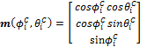
Inverse Parameterization & Camera Centric Coordinate
Notes:
A feature point in the scene is represented by 6 parameters. x, y, z represent the initial position of the sensor when the feature is first observed. Rho is the inverse distance from the initialization position to the feature. The phi and theta is a elevation-azimuth pair that encodes a unit vector m pointing from the initialization point to the feature. The vector m can be decoded by the formula at the lower right corner.
When the feature is first observed, xyz will be (0, 0, 0). As the sensor moves away from the feature initialization point, x, y, z, phi, and theta must be updated every frame referenced to the new coordinate defined by the current camera location. Rho is a scalar, therefore does not need to be updated.

Slide 7
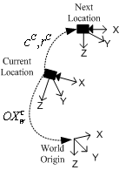
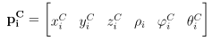
Full State Vector
World frame coordinate and orientation in camera frame.
Camera motion parameters :
Landmark coordinate in camera frame
Notes:
Now we introduce the full state vector of the EKF. The full state vector include a vector OX which contains the coordinate and orientation of the world reference frame. C, and r contains the camera translation and rotation motion every frame. P contains the features parameters mentioned in previous slide. The superscript C on the parameters represent that this parameter is defined reference to the camera.

Slide 8
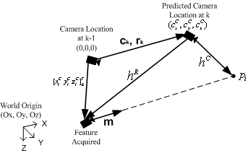
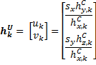
Measurement Model
Projected vector viewed at the predicted camera location
Landmark projected onto image plane
Notes:
This slide illustrates the measurement model of the extended Kalman filter. A measurement model describes the relationship between the state vector and the measurement which is the feature coordinates in image plane. This image illustrates the relationship. First the origin of reference frame is located at the previous camera location. The new image frame is captured at the current camera location which we made a prediction of its where about in the prediction state. The camera translation parameters describe a vector pointing from the origin to the predicted camera location, we’ll call this vector c. The xyz in feature initialization parameters describe a vector pointing from the origin to the feature initialization point, we’ll call this vector xyz. The vector Hr pointing from the predicted camera location to feature initialization point can be calculated by subtracting c from xyz. The vector hc pointing from the predicted camera location to the feature can be calculated by summing the normalized Hr and vector m. The normalization is needed because vector m is a unit vector. We must pre-multiply hc with the inverse rotation matrix because the summation defines a vector viewed from the previous camera point of view, and It must be transformed to the current camera’s point of view. Now, this vector can projected onto the image plane to get the feature’s location. The Sx and Sy are projection scaling factor obtained through camera calibration.

Slide 9
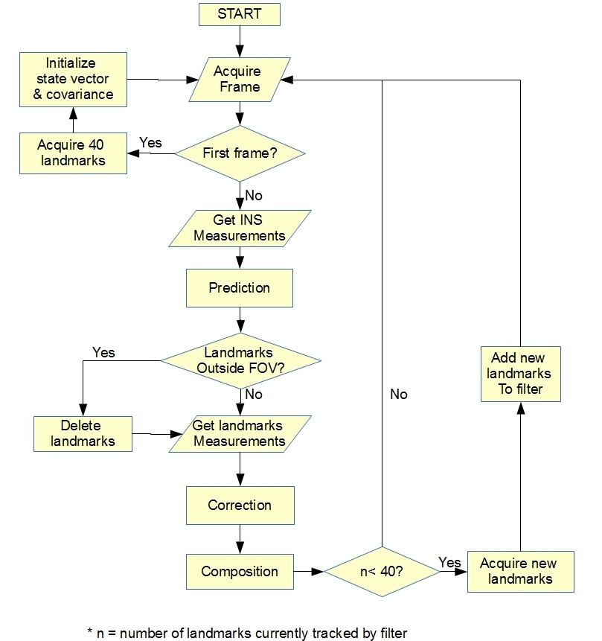
Algorithm Flow Chart
Notes:
The flow of the algorithm is a standard Kalman filter. At the first frame of the video, we detect feature and construct the state vector and covariance matrix. The feature detector is a standard Shi-Tomasi corner detector available in OpenCV. After initialization, the algorithm goes into a loop. First a new image frame and inertial data are captured. Then in the prediction state, camera position at which the new image frame is captured is predicted. All other parameters stay unchanged. In correction state, features are found in the captured frame using the pyramid Lucas-Kanade optical flow method in openCV. Based on the feature location in the image, corrections are made to the camera motion and feature parameters. A more detail illustration of the measurement model will be shown in the next slide. The last step in the loop is the composition. This step is necessary because of the camera centric coordinate system. In this step, the camera reference frame is moved to the next location using the corrected camera motion parameters, and the covariance matrix is also updated.

Slide 10
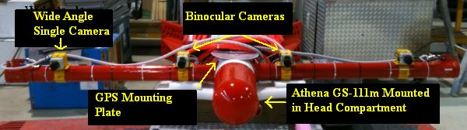
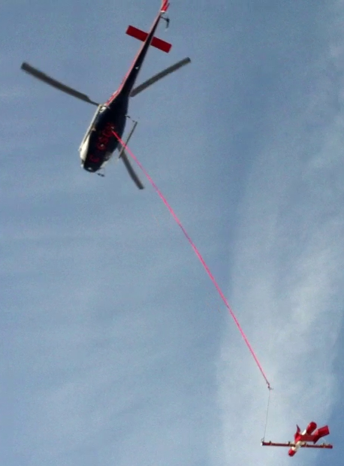
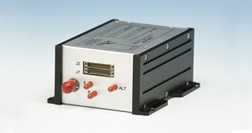
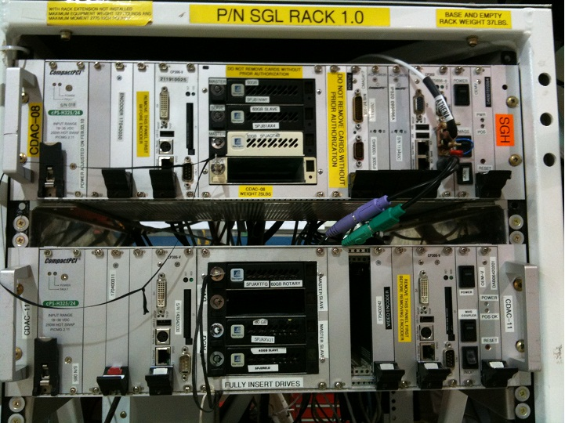

Data Collection
GS-111M
GPS Antenna
CDAC
Notes:
In order to examine the algorithm’s performance in a realistic low-flying condition, a test flight was conducted. To achieve the true flying altitude which is less than 100m above ground, a simulated unmanned aircraft system was used to carry all sensors and towed by a helicopter via a tow rope of 33 meters long. Sensors mounted on the SUAS included one wide angle CCD camera with 6 mm focal length capturing monocular video at 30 fps, one GPS antenna, and one INS/GPS navigation unit Athena GS-111m. Analog video captured by the cameras was digitized to 720x480 resolution images and time-stamped with GPS second on the image screen for post-flight synchronization with the inertial measurements.

Slide 11
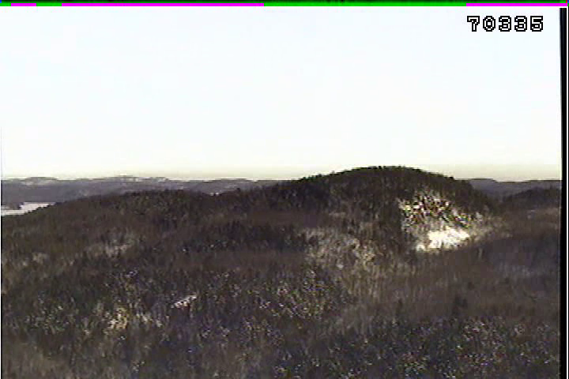
Image Example
Notes:
This is an example image captured by the monocular camera.
**Change this to a piece of movie**

Slide 12
Flight Result and Discussion

Slide 13
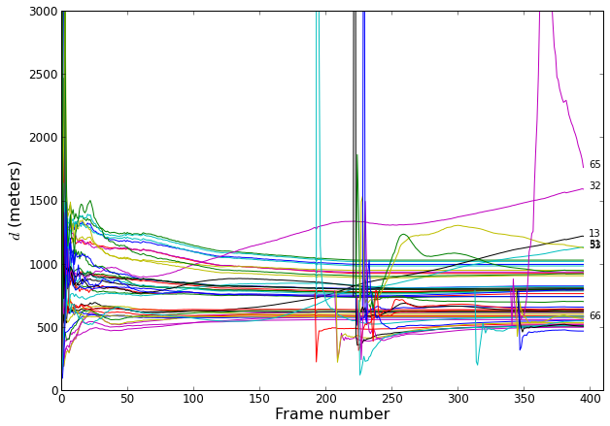
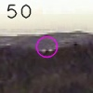
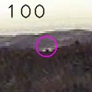
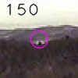
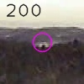
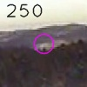
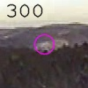
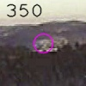
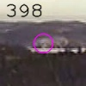
Range measurement over Iterations
Notes:
As a preliminary test of the algorithm, 40 features are initialized at the first frame, and a total of 200 frames are processed. This plot shows the features range over frames. Most features ranges start to stabilized after the first 10 frames, and at the end of the 200 frames, most of them converge to a stable value except for a 2 outliers. We can also see that all these features are very far, ranging from 500 to over 1000 meters from the sensor. This confirms the algorithm’s ability in handling distance features. Landmark 13

Slide 14
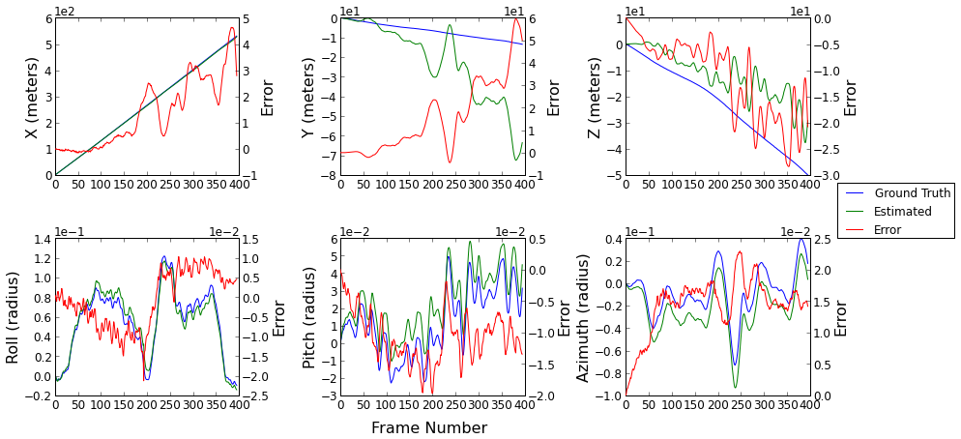
Self Localization Accuracy

Slide 15
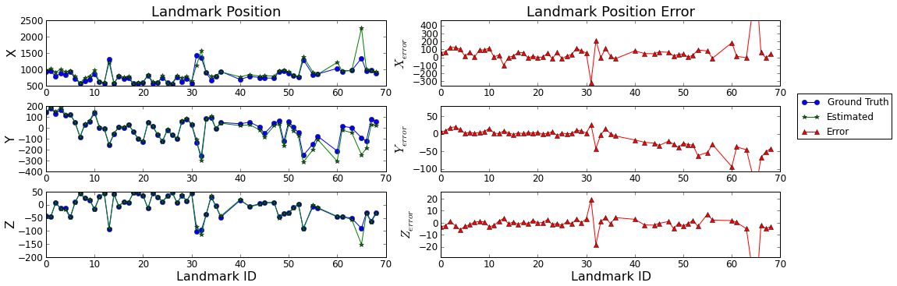
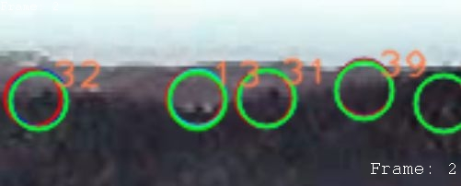
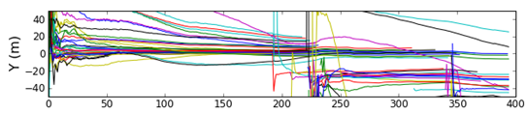
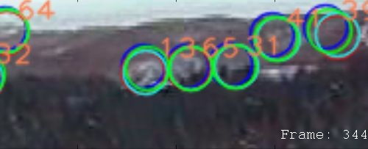
Landmarks Mapping Accuracy
Landmarks positions agreed with DEM
Landmarks added after 1st frame had offset error
Landmarks located at hill edge carried bigger error
Landmark position tracking (Y-axis)

Slide 16
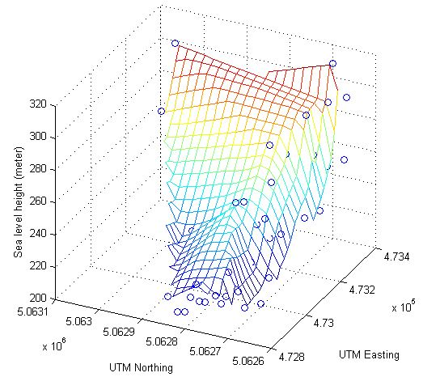
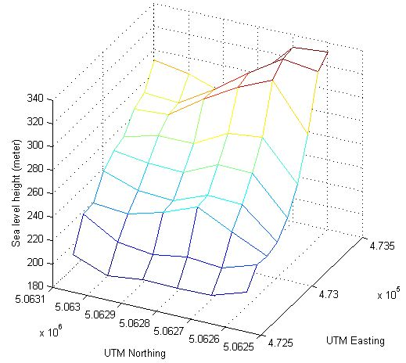
Elevation Map from Camera vs. Ground Truth
Elevation Map Constructed from Features Parameters
Ground Truth
Digital Elevation Map (DEM)
Notes:
A terrain elevation model is constructed from the features parameters, and compared to a digital elevation map. Due to lack of texture in part of the image, there were very few feature in the left side of the map. However, for the area where sufficient number of features can be extracted (front and right side), the terrain map from camera accurately mirror the ground truth map. In addition, the algorithm can capture features at denser spacing than the DEM. This allows us to produce a higher resolution map than the ground truth map in the rich texture region. This result suggests that with a high resolution high dynamic range camera, the algorithm would be able to produce high resolution terrain map and detect obstacles that are not shown in DEM

Slide 17
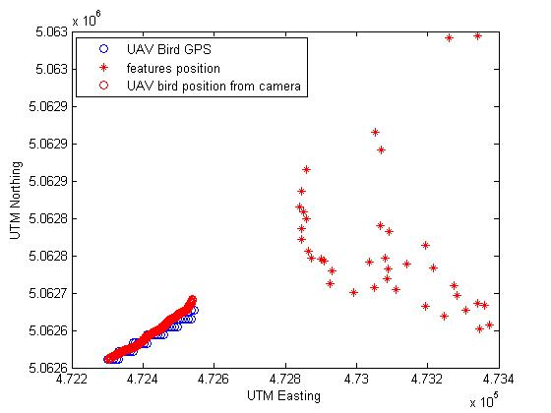
UAV Position Estimated from Camera
Notes:
The UAV’s position at each frame can be reconstructed from the world reference frame position and orientation. The reconstructed UAV flight path is compared to the actual flight path recorded by the GPS. The reconstructed trajectory is over 250 meters long. For the first 200 meters, the camera result agrees with the GPS result very well. There is a light diverge in the last 50 meters. Whether this is a temporary diverge or a true divergence, we need to project a bigger area to find out. On the other hand, the algorithm provides a more detailed UAV position than the GPS.
**See if we can change this figure to 3D**

Slide 18
Conclusion on Flight Data
An inertial aided inverse depth Extended Kalman Filter framework
Outdoor flight video data collected using a SUAS towed by a helicopter
Result of the algorithm provides accurate estimates for features positions and the sensor’s own location
To obtain high resolution terrain elevation map, camera with high resolution and high dynamic range is required.
Notes:
In conclusion, we presented an inertial aided inverse depth Extended Kalman Filter framework. The filter generates sparse terrain map from monocular image sequence. The algorithm was tested with realistic outdoor low-altitude aerial video data collected using a simulated unmanned aircraft system towed by a helicopter. The outputs of the algorithm include terrain elevation map and the UAV’s own position. Despite the large scale of the measurement environment, the results obtained by the algorithm were accurate for the image sequence processed. We found that the key factor that limits the resolution of the generated terrain map is the quality of the captured video. Being a vision system, the algorithm requires rich texture in the image to extract sufficient number of features. With a high resolution high dynamic range camera, the algorithm would be able to produce high resolution terrain map and detect obstacles.

Slide 19
Error Analysis through Simulation

Slide 20
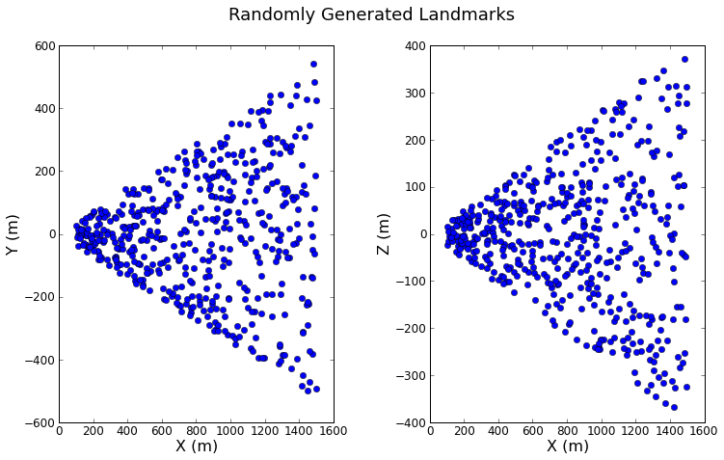
Simulator Setup
Simulator is used to analyze error source. Scenarios includes:
Forward motion only, no digitization noise, no camera calibration error
Oscillatory motion on all other 5 d.o.f. added individually.
Camera calibration error introduced individually
Various image resolution
Virtual landmarks generated by random number generator within FOV of camera, ranging from 100m to 1600m

Slide 21
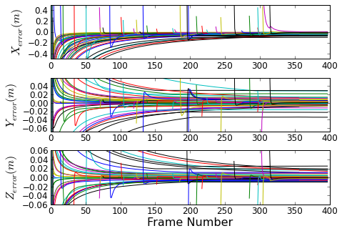
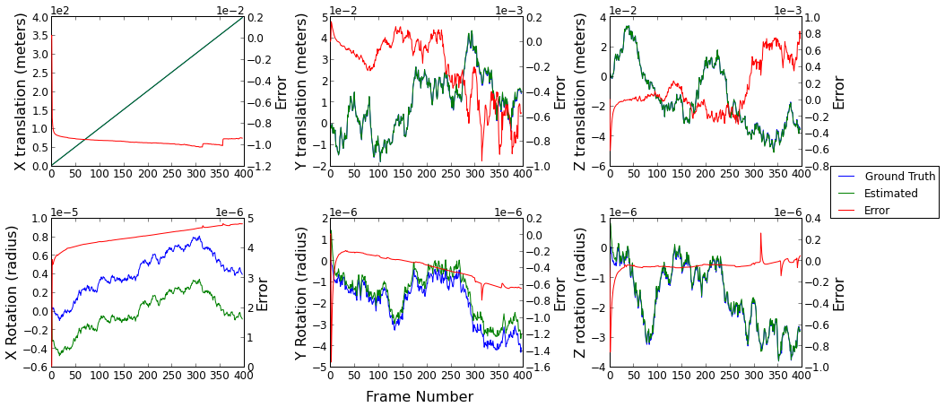
Forward Motion
UAV position error < 1cm
UAV orientation error < 3e-3 degrees
Landmark position error on X < 0.2m
Landmark position error on Y & Z < 0.02m

Slide 22
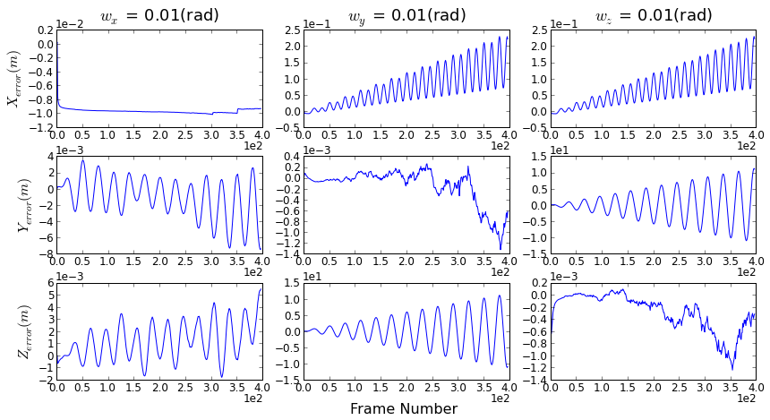
Self Localization with Added Oscillatory Motion
Translational motions had minor effect.
Rotational motions on Y and Z affected localization significantly
Pitch affected UAV position estimates on X and Z
Azimuth affected UAV position estimates on X and Y
Errors are diverging and oscillatory
UAV position error with rotational motion set at 0.01 rad/s
Notes:
Add plots showing UAV motion

Slide 23
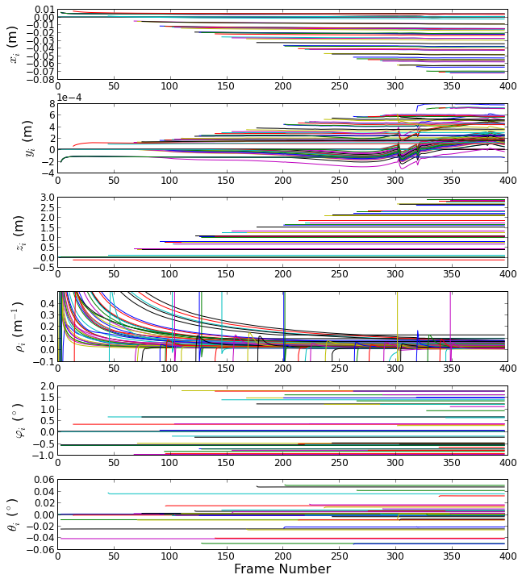
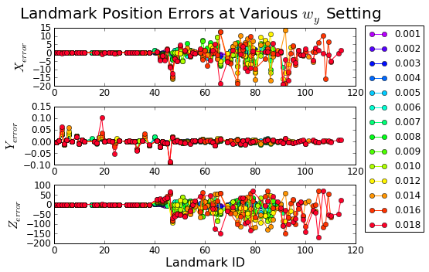
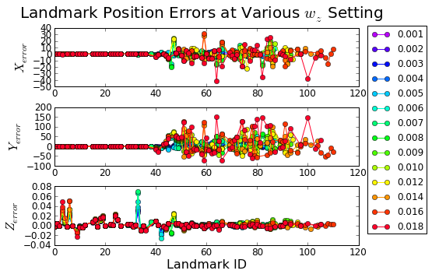
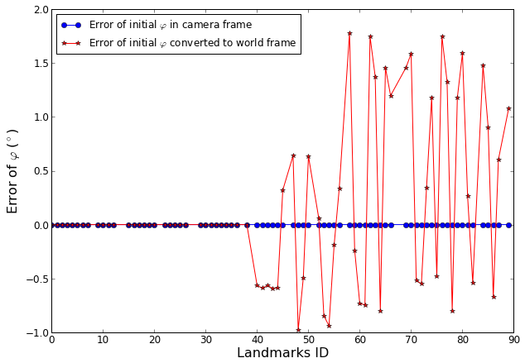
Landmark Mapping with Added Oscillatory Motions
Translation and rotation on X axis had minor effects
Rotations on Y and Z has significant affects on landmarks added after first frame.
Due to UAV localization errors

Slide 24
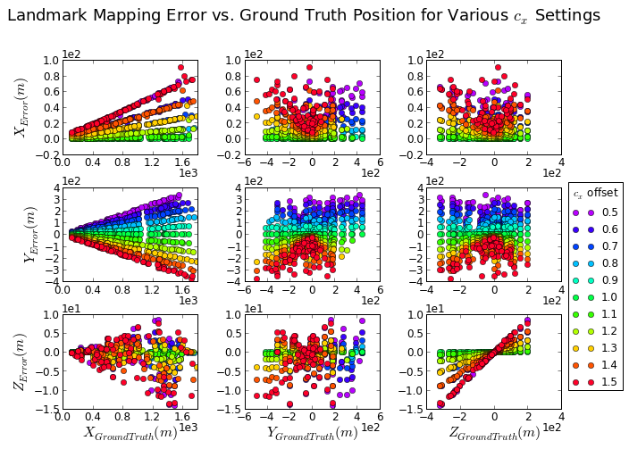
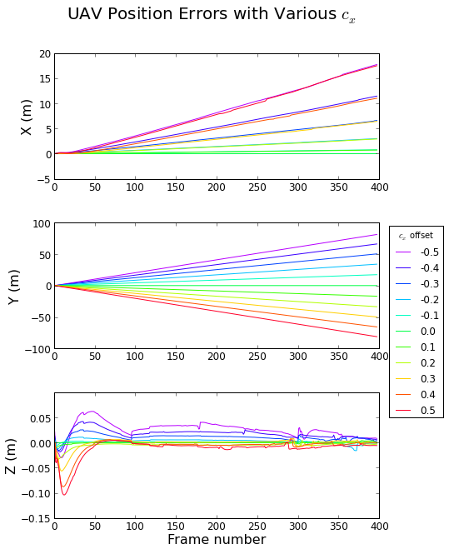
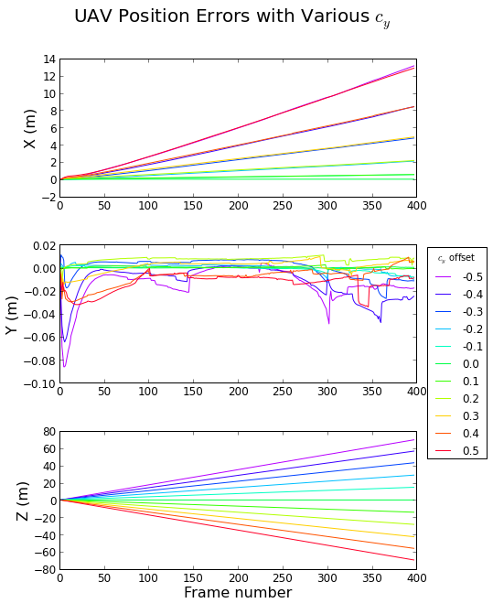
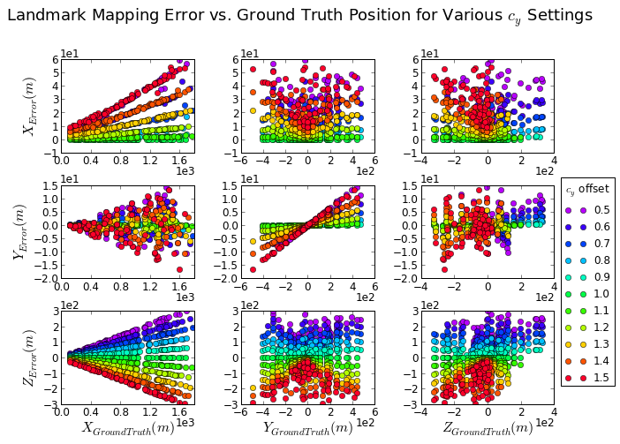
Error in Camera Calibration cx & cy
Errors in localization were diverging.
Errors in mapping were dependent on the landmarks locations.

Slide 25
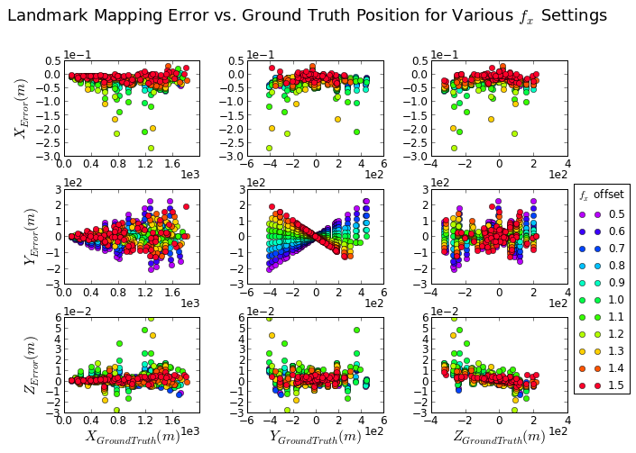
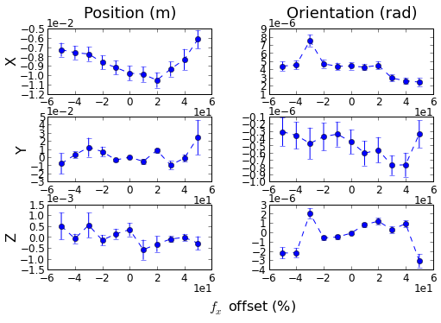
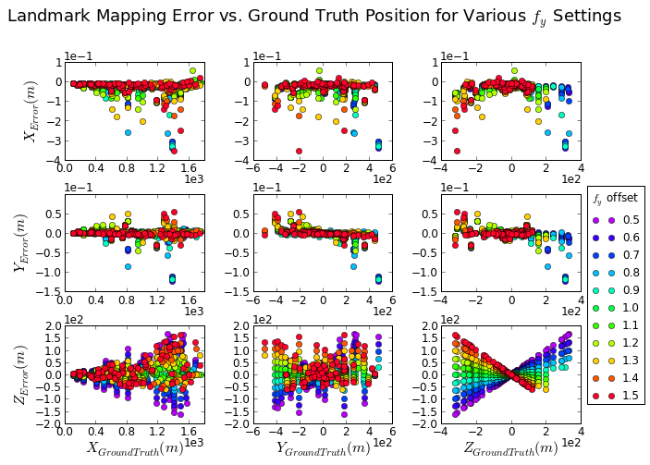
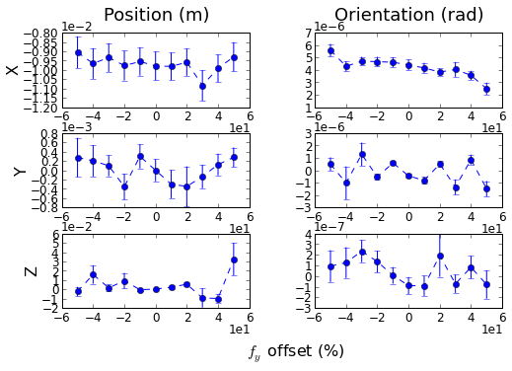
Error in Camera Calibration fx & fy
Little effect on localization
Errors in mapping were dependent on the landmarks locations.

Slide 26
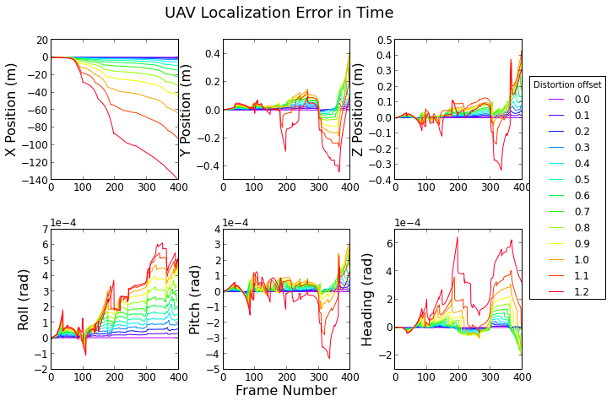

Error in Camera Calibration Distortion
UAV localization errors were diverging in time.
Landmark mapping is dependent on the distance of landmark from optical axis
Landmark error vs. Ground truth

Slide 27


Effect from Image Resolution
asdfds
Image resolution has big affect on the result accuracy
Error at 480px720p were significantly bigger than other resolution
Desired resolution is 1080px1440p or higher for the landmark at about 1000m

Slide 28
Conclusion – Flight Data
2 pieces of video were processed
The algorithm is feasible in mapping distanced objects
From 1st video:
For SUAS localization, error accumulated over time and reached 20m on X, 50m on Y and 30m on Z
For landmark mapping
Furthest landmark mapped is 1600m
Average error is -56m on X, 13m on Y and 1.3m on Z
Landmarks not initialized at first frame carried offset error
Landmarks at mountain top carried more error

Slide 29
Conclusion – Flight Data
From 2nd video:
SUAS localization error agreed with result from 1st video
For landmark mapping
Average error is 150m on X, 40m on Y and 20m on Z
All analyzed landmarks are on lower left corner of the image. Error are likely due to lens distortion

Slide 30
Conclusion – Error Analysis
Impact from motion
Simple forward flight:
UAV localization error: Position < 1cm, Orientation < 3e-3°
Landmark mapping error: X < 0.2m, Y&Z < 0.02m
Oscillatory Motion on the other 5 D.O.F
Translation on Y axis and Z axis has little effect on localization and mapping
Rotation around X axis (roll) has little effect on localization, and increase mapping error by meters
Rotation around Y and Z axis has significant effect on localization and mapping
Increase localization error by up to 30 meters
Increase mapping error by hundreds of meters

Slide 31
Conclusion – Error Analysis
Impact of Error in Camera Calibration
Effect from (cx ,cy)
Caused diverging error in localization
Mapping error is proportional to landmark position, and dependable on error in (cx ,cy)
Effect from (fx, fy)
Caused little error in localization
Mapping error is proportional to landmark position, and dependable on error in (fx ,fy)
Effect from lens distortion
Caused diverging error in localization
Mapping error is proportional to the landmark’s distance from optical axis

Slide 32
Conclusion – Error Analysis
Impact from Image Resolution
Error at 480px720p were significantly bigger than other resolution
Desired resolution is 1080px1440p or higher for mapping landmarks ranged at about 1000m

Slide 33
Future Work
Include lens distortion model
Increase sensor resolution should future flight become available
Add algorithm to filter bad quality landmarks
Add map joining algorithm to enable better accuracy in large area application
Add GPS syncing to improve accuracy when GPS is available

